Slide 1
Supply and Demand:
Oils and Oilseeds
Istanbul – September 19, 2019
Gregoire Deschamps

Slide 2
Structure
Sunflower seeds fundamentals
  Crops
  Trade flows
  Exportable surplus
Sunflower meal
Sunflower Oil
Crush margin in Europe
Sunflower oil relative to other oils
Biodiesel
Soybeans
Canola / Rapeseed
Trade war

Slide 3
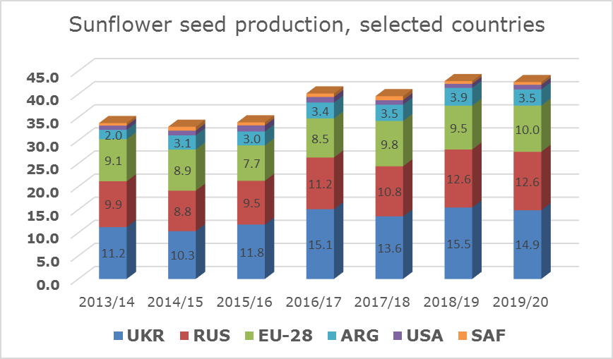
Global sunseed market
EU:
  Record high crop
  Higher acreage
UKR + RUS
  Good growing conditions
  Massive acreage
  Big crop
Bearish sentiment short term
  Southern EU bids / buyers market for now
Low volatility (vs SBS & RS) until past 3 weeks decline
Notes:
Ideal conditions in most of Europe led to high yields combined with higher acreage gave us a record crop this year in Europe at 10 mmts
Conditions in Ukraine and Russia were good, thanks to timely rains and still big area similar to last year
The market is expecting another big crop in Ukraine but slightly less than last year. And as big as last year in Russia
The overall sentiment is bearish – definitively feels like a buyers market with S.EU origins bidding far below replacement FS
However, discounts to other oilseeds are large and consumption should adjust somewhat
While RS and SBS had an extremely volatile summer price wise - SFS didn’t rally and didn’t decrease drastically either before last month

Slide 4
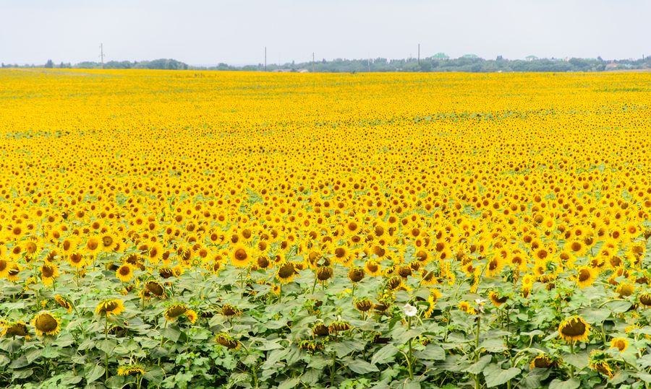
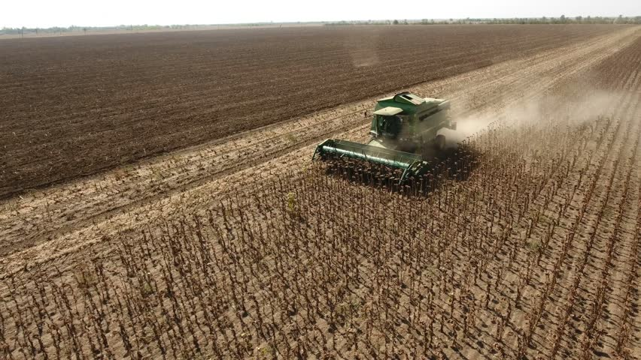
Ukrainian sunseed market
Acreages stabilizing as it seems to be maxed out now
Crop rotation not allowing any increase anymore
100% ROI at planting
Good growing conditions
Notes:
Farmers seems to have reached the point in Black sea where crop rotation doesn’t allow them to grow more sfs. So we have seen the area stabilizing vs last year despite the fact that sfs remains the most profitable crop for framers.
This situation shld remain the same going forward.
As you can see conditions have been great this year. The crop will most likely not reach last year level but overall still a very decent crop around 15mmts. Crush is expected to be reduced as well leaving the market with a balanced SnD.
We could see higher export during the second part of the campaign eventually to Europe.

Slide 5
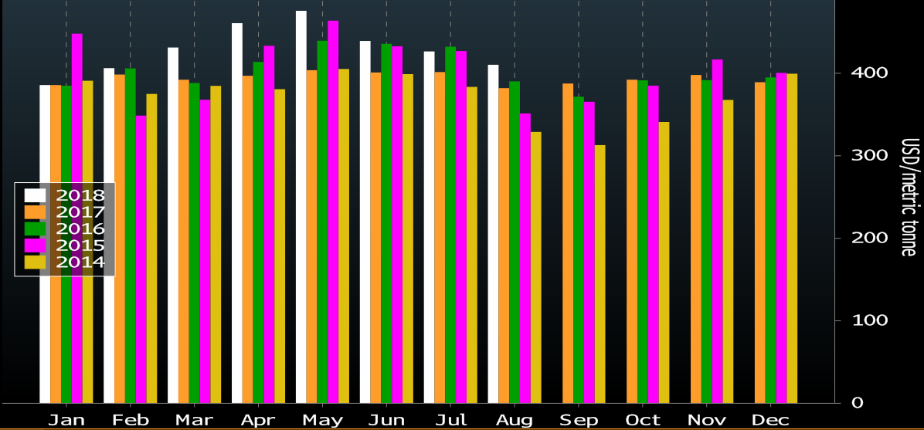
Ukrainian sunseed seasonal
Seasonality
  Crush capacity early in the season
  Follower by seed availability
  Seasonal lows around now
Rains slowing down harvest
20% harvested
  3.2mmt of 14.9mmt
Farmer selling at 8%
Notes:
Seasonality: driven by crush capacity early on and seed availability later in the season.
At the moment crush capacity and the harvest speed determines the price and we are in the period where the seasonal low is generally found
At the moment 20% crop is harvested (3.2 MMT out of 14.9 MMT crop).
Average yield pretty unchanged at 2.4 mt/ha confirming the crop expectation ard 15 mmts
Farmer selling is low at 8% only. The market is relatively low locally not encouraging farmer to sell in style. On top they have seen very high prices at the end of last season making them reluctant sellers today.

Slide 6
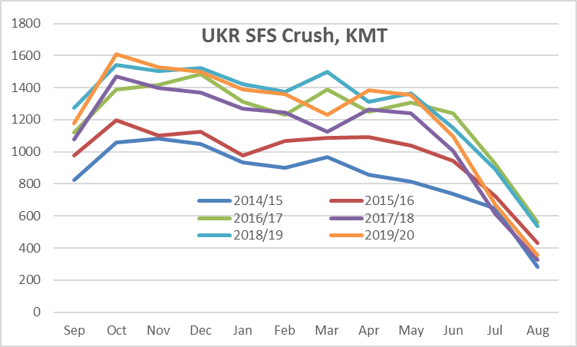
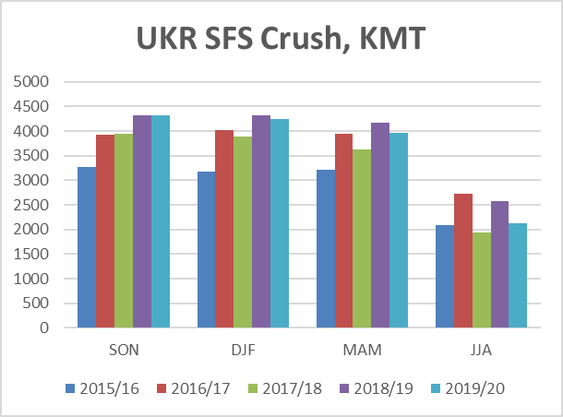
Ukrainian sunseed crush
99% crushed locally
Ample seed availability expected
Crush margin = USD 25-35
Notes:
As we said exports are about 2X more vs LY – about 200kmt, 99% of the UKR crop is crushed locally
Early on we can expect crush to run fully, taking advantage of harvest pressure and ample seed availability
Later on the crush pace declines as we head into the seasonal part where seed availability takes the lead.
this year the seeds availability first takes the lead around Jun/Jul/Aug
Toward the 2H of the season crush usually is starting to slow down supporting oil prices
Crush margins are positive 25-35 USD gross

Slide 7
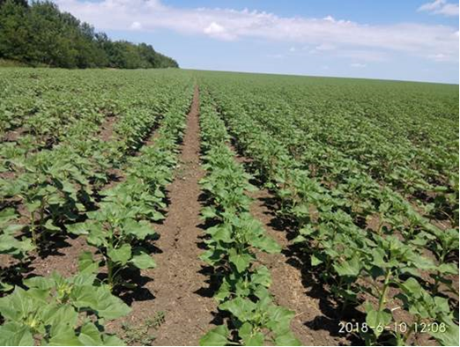
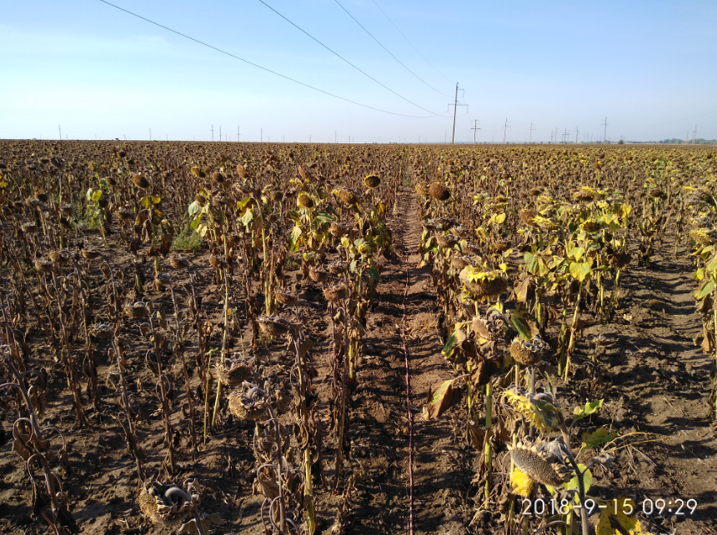
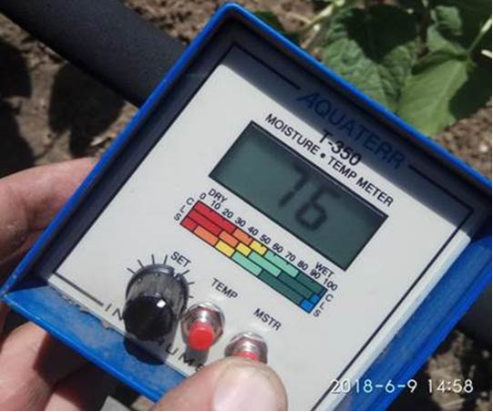
Russian sunseed market
Planting went well
Good soil conditions
Homogeneous fields and low weed pressure
Head of plant is full
Fit for storage
Same crop size
Notes:
Planting went well in the large picture, acreage are more or less unchanged from last year, crop should be stable ard 12.5 mmts
Timely rains in July august have ensured a good development of the plant
Homogeneous fields during early stages and low weed pressure
The crops did not experience stress during the summer vegetation either, no cracks in the field, head of plant is full,
Fit for storage in many areas

Slide 8
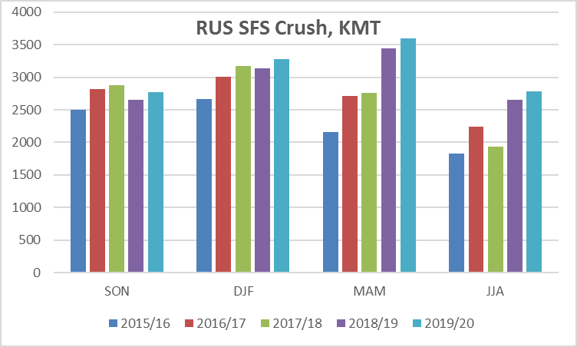
Russian sunseed crush
Crush will remain the main demand
Potential for coasters to be exported (similar to last year).
Most likely will be competitive when Romania and Moldavia is over
Notes:
The larger crop is mostly absorbed into the crush – which increases by 4% (in RUS 99% is crushed as well), while export should move a bit lower than last year due to bigger availability in Europe.
Same patterns as in UKR, major crushing's early in the season Jun/Jul/Aug decreases
Almost the highest crush pace in all quarters during the past 4 seasons
All in all the SnD will remain well balanced with minimum carry over.

Slide 9
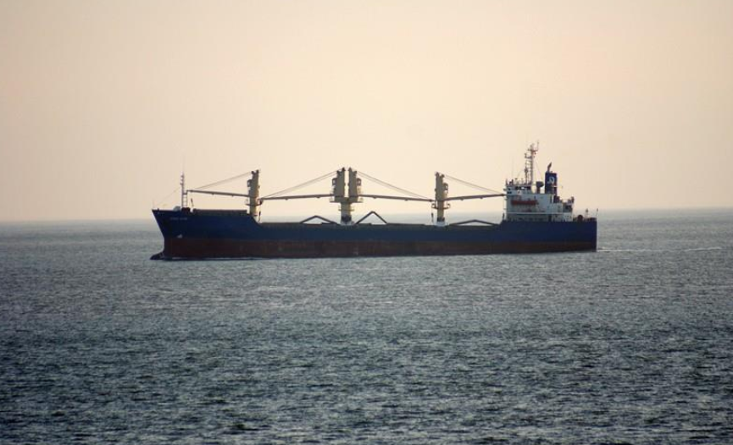
European Union sunseed market
Good growing conditions in most of Europe
Hot and dry weather in France leading to a lower than expected crop
  Good start and steady decline
Increasing import / decreasing exports
  Balancing Bsea SnD
  Coasters
Notes:
Record high yield and crop in Romania and Bulgaria thanks to record high acreage and ideal conditions.
Sunflower crops are struggling in FRA
After a satisfactory start - the plants suffered from the very hot, dry weather observed since early July.
Despite France being lower the EU crop is expected to reach a record high 10 mmts as acreage and yields are both record high this year.
Crush is expected to increase by 1 pct as oil demand grows. Import should decrease as we shouldn’t see too much Argentinian sfs being competitive to EU this year.
Exports will also decline by 18% the crush margin is very healthy in the EU so crushers will secure the loacal seeds as much as possible leading to less exports all in all.

Slide 10
Romanian + Bulgarian + Hungarian sunseed market
Hungary
  Excellent crop ahead with good growing conditions in general
Romania
  Excellent growing conditions with timely rains in July and aug
  Record high yields and record crop ard 3.5 mmts.
  Abt 2 mmts exportable surplus this year.
Bulgaria
  Similar conditions to ROU
  Excellent yield leading to abt 2 mmts crop.
  Local demand growing keeping exportable surplus modest
Moldova
  Good condition and crop up 200 kt from last year.
Notes:
Hungarian crop similar to last year ard 1.8 mln tons. Conditions have been great despite some dryness concerns at some point.
Romania record high crop this year as mentioned earlier so big exports potential. Moldova ard 550 kt vs 400 kt last year for the same reason than Romania.
Bulgarian crop should reach 2 mmts this year. But local demand keeps on growing as expellers market is growing too. The loacal demand should reach 2 mmts leaving Bulgaria with limited export potential. And possibly good import demand.

Slide 11
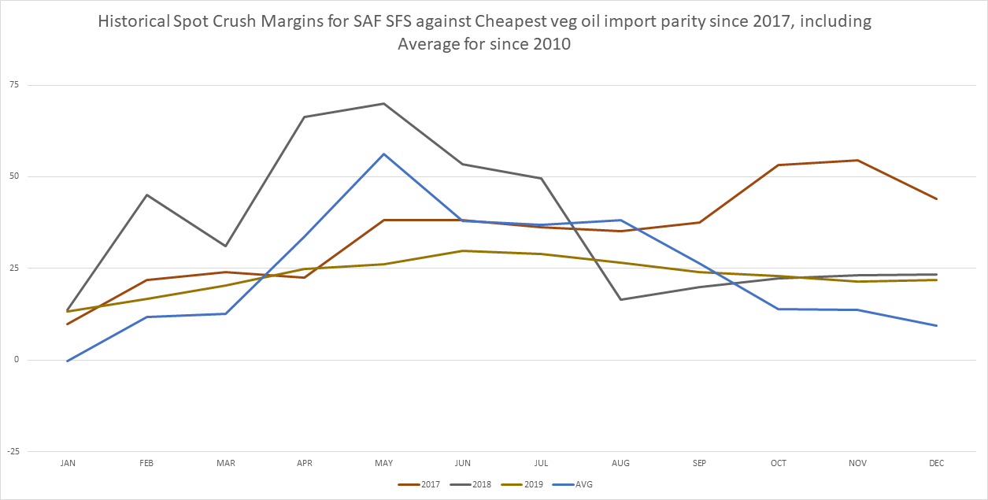
South African sunseed Market
Planting Nov-Jan
  Acreage dependent on Corn planting (high volatility)
Last SFS export 2009
  Low quality (36% oil)
Last SFS import Jan 2017
  FX uncertainty
Import possible/Seasonal price highs
Harvest/Seasonal price lows
Planting
Planting
Notes:
Planting from Nov to Jan (Sometimes even Feb) each year, with hectares being incredibly volatile and difficult to forecast. The maize farmers all prepare their fields for maize but if they do not get the opportunity to plant by latest mid Jan due to weather, they will plant SFS so they don’t waste the inputs. This means the final SFS crop size is fairly dependent on the weather during the maize crop planting progress. Later planting gives lower yields
Seasonally cheapest in AMJJ (during harvest with Majority harvested in May) - seasonally most expensive in OND with products getting cheaper internationally and big product demand pull in SAF before holiday period
Exports: SAF last exported SFS in 2009. SnD is far from that of a surplus SnD in general. Difficult to find export destinations as the SAF SFS has an incredibly poor oil content making it undesirable.
Imports: normally import OND shipment. SAF tightest at the same time as NC BSea starts to get harvested, which means if we reach import parity in the year, it would be around this time period. We would import from the EU as we get this stock duty free, and we benefit from the higher oil content. No imports since Jan 2017 due to relatively heavy SnD since.
There is a possibility this year to import, however import parity is more than what our current crush margins ($60 from import parity vs. $45 Dec CMX). Logically we should kill crush in the country before we import
Large FX related uncertainty

Slide 12
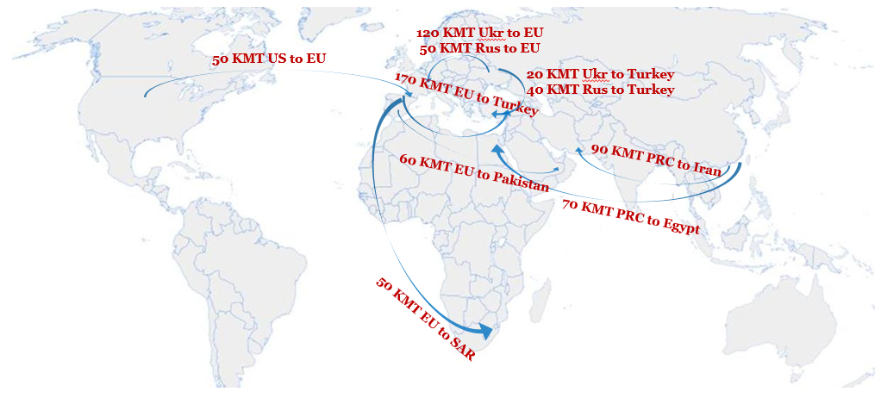
Sunseed trade flows
No ARGY export
Limited demand from PAK
  Massive SBM stocks
  Low poultry margin
Stocks available for Turkey
Notes:
Given the bigger production this year, Europe should import next to 0 argy sfs.
With canola and beans getting cheaper and cheaper because of the trade war, the flow to Pakistan should remain very limited in the coming season
Pakistan is importing massive amounts of Beans and struggle with large sticks of meal.
This year PAK imported 2.5mmt SBS and most of it from the US
The overall SBS import is up 14% year on year
EU Crush margin are good and we expect 120kmt from UKR to EU
Turkey will depend on the FX rates and CMX with some uncertainty, but we assume there will be imports from EU (170kmt), RUS+UKR (60kmt) and
South Africa has potential for some imports, but very uncertain at the moment due to crop and FX. Expect Zero exports / somewhere between zero and 50kmt imports

Slide 13
Sunflower meal potential
China minimizing US origin SBS import
  Large increase in spreads over US SBS
  Strong margin for other origins crushing US beans
SFM should keep on getting interest from China
Price attractive vs Rapeseed meal in Europe
Export out of Ukraine more or less unchanged vs last year.
Russian sunmeal soon going to China?
Notes:
Due to trade war China keeps SBS imports from the US at minimum wile south American is getting the priority for Chinese crushers
With current situation the meal demand from China remains strong and they should keep on buying SFM from Ukrain at the similar pace than last year.
Russian origin is now a clear options on the table, but China can only import from certified plants which take some times. Russian meal should start trading to China only in 2020 agw (Q2).
Overall the situation is quite supportive for sunmeal with demand growing.

Slide 14
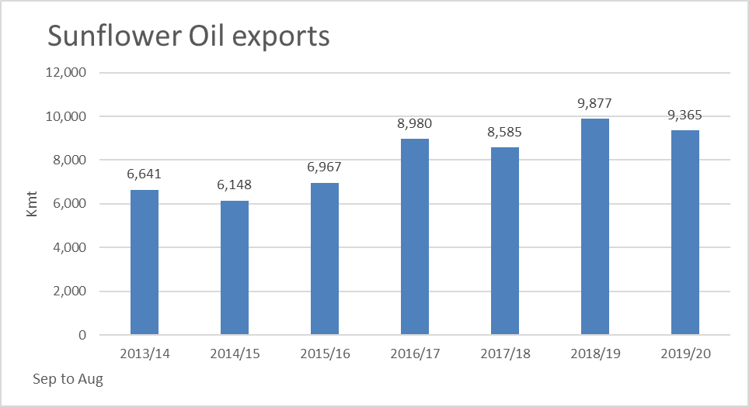
Sunflower oil
SFO exports have reached a new record high last year.
Stronger demand due to low prices vs other oil and lower canola oil prod in China.
Lower exports forecasted for this year due to lower crop in Ukraine.
Notes:
After the recovery of the SFS production last year in Black sea, the export of sunoil have reached a new high last season at 9.9 mmts, most of it out of Ukraine and Russia.
Sunoil have been cheap enough in the first half of the season to attract additional demand. On top of it China has been slowing down the production of canola oil boosting the demand there as well.
For this campaign overall demand should remain strong but oil production will be smaller in Ukr + local consumption in the EU shld stay strong because of the Biodiesel demand.

Slide 15
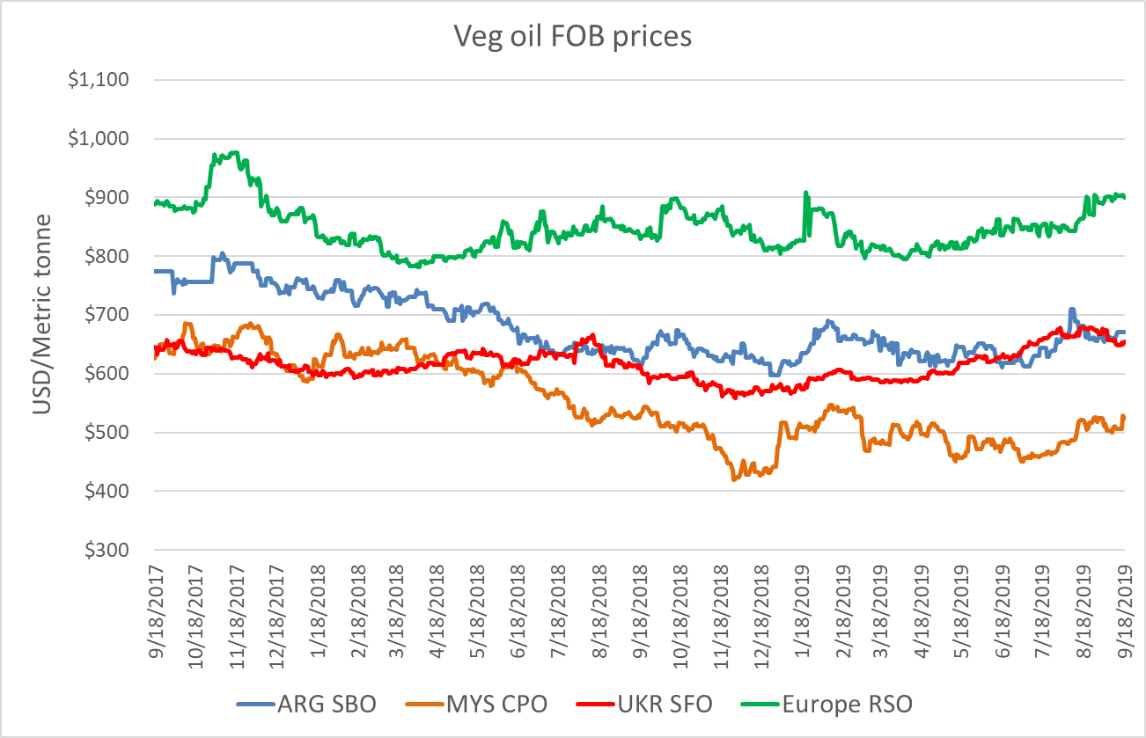
Sunflower oil vs other oils
Since 1st of Jan:
  RSO increasing
  SBO rising
  SFO at increasing discount to RSO
    Shortage of RSO
    Harvest pressure now in Black sea
SFO is buying market share in the EU. Stay competitive to other destination.
Notes:
SBO - Argentina
SFO - Ukraine
RSO - Europe
Relative values speak against RSO consumption, RSO has been steadily increasing for the past 6 months. The market need to find a way to ration demand as the crop was small this year
SBO has been quite volatile since 1st of Jan but all in all firmer as well
SFO had a very strong move especially end of Q2 and Q3. discount with SBO have boosted export and lowered the stocks for the end of the season.
Right now sunoil developing a discount again as we are feeling the harvest pressure from Black Sea but its unlikely that we see similar discount to last year as demand feels already big today.
Palm still the cheapest and no major fundamental driver on the radar to shake that situation.

Slide 16
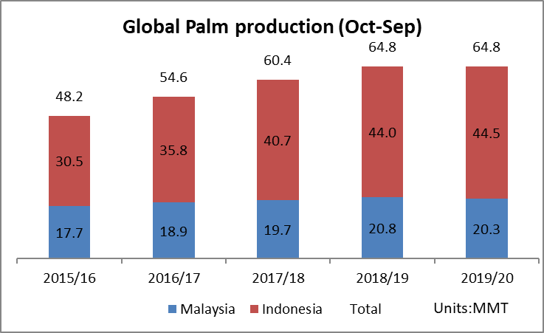
Palm oil
Excess stocks reduced
  Past year excess palm has lower flat price and stimulated the demand. Besides lower SBO availability for China due to the trade war with the US has favored Palm
  2020 Indonesia biodiesel obligation could rise from B20 to B30 adding 2.4 Mmt of demand
PME import margins to EU are gone
  New counter vailing duty
  But will be replaced by PO export
Notes:
Palm oil SnD is slowing decreasing its excess palm oil stock thanks to big demand from China
Past 6 months Malindo PO stock have been declining. Excess product has lowered the price which in turn has stimulated the demand in India and China. The trade war US/China has lowered SBO availability in China that has been partly replaced by Palm
At the moment Palm is still the cheapest oil in the market. With current counter vailing duty on Indonesia PME, the PME production is being shifted to Europe but PME exports are being replaced by Palm exports.
On the radar coming in January 2020 is the B30 mandate in Indonesia (adding 2.4 Mmt of demand in 2020)

Slide 17
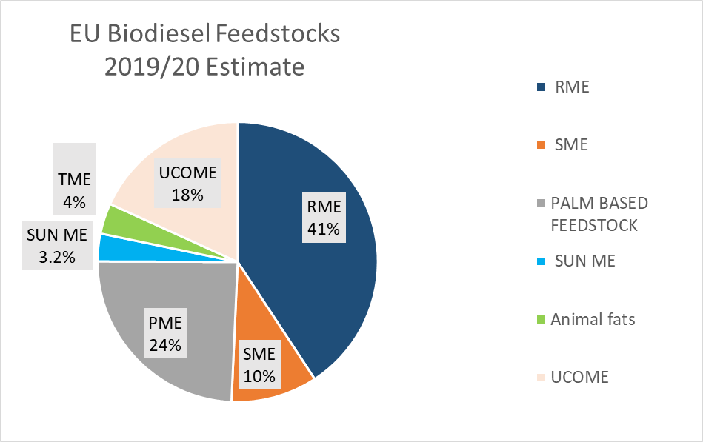
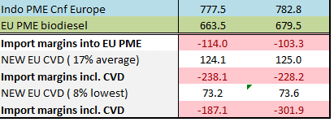
Bio-Diesel
Q4 19
Q1 20
ARGY SME will still find its way to Europe despite
  New export tax differential
  +2 to 6 USD/mt blending margin going forward
SFME possible in Spring and Summer
  Some producers have overcome technology hurdle and more SFO can be processed
  Current RSO/SFO premium at 250 USD
Notes:
Stable bio-diesel use, but next year higher obligation for 2020 will push up the demand
SFO based Methyl ester – low at only 2.3% of overall blend last year
Likely to increase as a cheaper alternative than RME during mild to high temperature seasons, but limited use in Winter due to insufficient cold property
AGY SME will still find its way to Europe and keep Summer prices low
In Europe, RME production margins are highly positive for Winter (Q4 19 & Q1 20). Keeping rapeseed prices well supported.
PME import margins into Europe are deeply negative to -190 in Q4 19 & -300 in Q1 20 due to the new E28 counter vailing duty on Indonesian PME

Slide 18
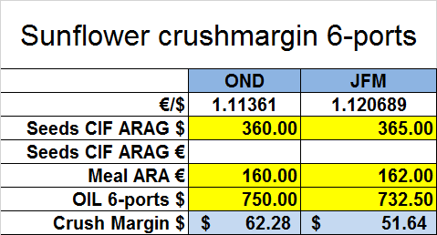
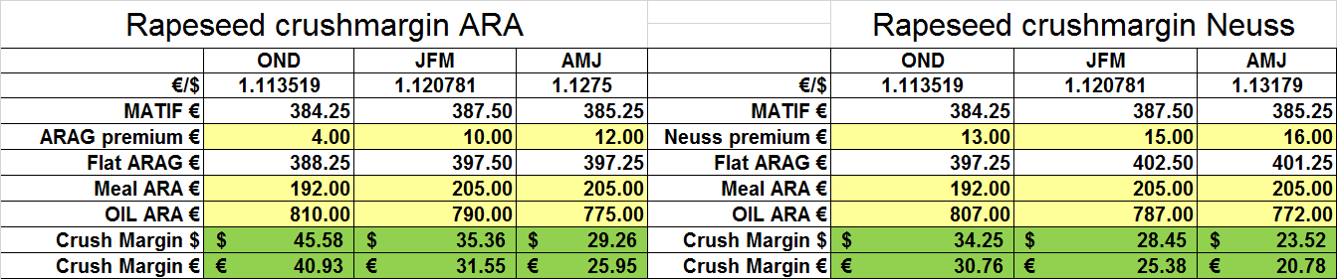
European union crush
OND margin on Rps and SFS very healthy
Soybeans margin ard 25 usd gross.
Limited switch to soybeans expected at least until April.
Sunflower margin encouraging EU crushers to cover their needs now.
Notes:
At the moment CMX in EU is very decent, and crushers are happy to run on SFS and rapeseed, enjoying good demand.
At the moment the SFS CMX is relatively similar to RS for costal plants (considering costs) on OND, but for JFM SFS outperforms RS
Overall the environment is quite healthy in Europe so far. But the margin should change going forward on rapeseed as the market need to find a way to ration demand as from April.
Situation shld remain healthy in Europe as good demand for oil is expected and ample supplies should allow the crush to run at max capacity.

Slide 19
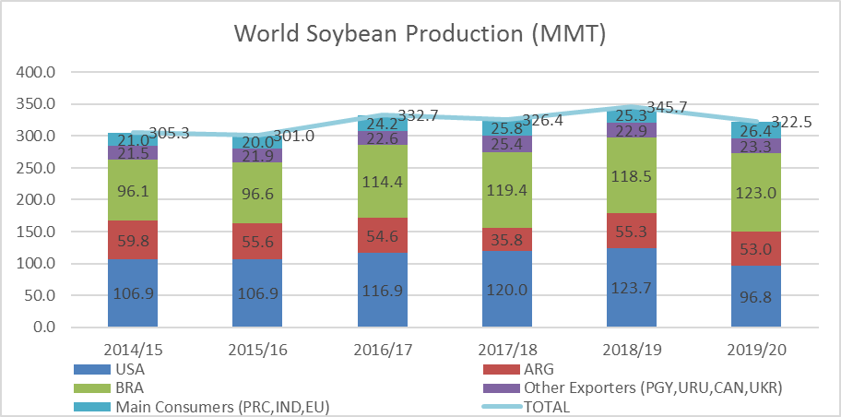
Global soybeans market
World production seen decreasing 7 pct
Largely on the back of the US down 27 mmts vs LY
C/O is tightening overall but remains comfortable in the US
Notes:
World production correcting to 322.5 mmts. Main reason being the lower crop in the US after poor planting conditions.
South America is seens more or less stable vs last year.
World carry over is tightening as China keeps on buying non US origin mainly while the US carry over is seen decreasing but should remains at comfortable level for the time being.

Slide 20
Canadian canola market
21mmt initially
  Delayed plantings
  Hot and dry
  Early frost
20.6mmt current estimate
Farmer selling focusing on wheat
Harvest still ongoing
Carry over keep on growing
Notes:
We started our crop estimates in Canada at 21 mmts few months ago, but have cut 0.5mmt over the course of the growing season
We had delayed plantings
and then hot and dry,
and now finally frost
C/O and stocks to use are exploding since last year, since China decided to slow down their canola imports.
70 pct of the crop is still in the fields but weather is turning dry now allowing farmers to make quick progress.
First yield confirms the big crop forecast.
Question is can farmers keep on storing 5 mmts of canola next year

Slide 21
European rapeseed market
Planting intentions lower from the start
  Winter kill
  Too wet spring
  Too dry planting and june
Decline of 2.7mmt or -14%
Extremely tight scenario
Notes:
Initially crop was already quite low due to bad planting conditions and C/O was already tight on paper.
Then we got winter kill followed by to wet conditions especially in FRA and Germany making the forecast even worst
And after that we got the extreme dryness in FRA and GER during June.
This lead to the decline of 2.7mmt or -14% vs Last year
Luckily, Canada is looking for a home for his Canola, and we should see a record flow from Canada to EU despite the fact that the crop is GMO. Discount of canola vs rps have reached 90 usd making the crush margin profitable enough to allow EU farmers to deal with the GM meal from canola.
But despite this flow the rapeseed SnD will be extremely tight this campaign.

Slide 22
China/US trade war
Current situation:
  Tensions and import taxes remains in place
  China covering soybeans needs from South America
  Meal import demand higher boosting Sunmeal flow from Black Sea
  Canola imports from Canada reduced sharply
  Import of oil bigger next year
What’s next?
  Negotiation have restarted between both countries.
  Can China guarantee higher import of US beans and AG products.
  What about canola?
Notes:
The China/US trade war remains the main market mover nowadays.
Current situation is relatively clear
Negotation have restarted lately but for how long no one really knows. If China agrees to guaranteed that they will ship more US ag products this will reshuffle the overall trade flow once again.
Canada has been indirectly involved in the trade war and China has been slowing down the canola import flow lately.
This has led to higher oil demand in China and to lower prices in Canada. It seems that canola is not one of the main topic of the negotiation but if the canola flow remains limited this will keep the oil demand fairly big in the coming season so definitely something to keep an eye on.

Slide 23
Thank you

